Slide 1
Chapter 3 Gate-Level Minimization

Slide 2
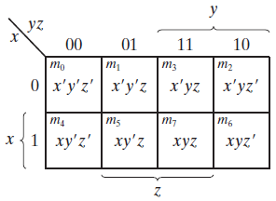
Three Variable K-Map
X | Y | Z | Term | Designation
0 | 0 | 0 | x’y’z’ | m₀
0 | 0 | 1 | x’y’z | m₁
0 | 1 | 0 | x’yz’ | m₂
0 | 1 | 1 | x’yz | m₃
1 | 0 | 0 | xy’z’ | m₄
1 | 0 | 1 | xy’z | m₅
1 | 1 | 0 | xyz’ | m₆
1 | 1 | 1 | xyz | m₇

Slide 3
Three Variable K-Map
X | Y | Z | Term | Designation
0 | 0 | 0 | x’y’z’ | m₀
0 | 0 | 1 | x’y’z | m₁
0 | 1 | 0 | x’yz’ | m₂
0 | 1 | 1 | x’yz | m₃
1 | 0 | 0 | xy’z’ | m₄
1 | 0 | 1 | xy’z | m₅
1 | 1 | 0 | xyz’ | m₆
1 | 1 | 1 | xyz | m₇
Minterms are arranged, not in a binary sequence, but in a sequence similar to the Gray code

Slide 4
Three Variable K-Map
F (A, B, C) = ∑(1, 2, 3, 5, 7)
Y
00 | 01 | 11 | 10
X
0
1
0 | 1 | 1 | 1
0 | 1 | 1 | 0

Slide 5
Three Variable K-Map
F (A, B, C) = ∑(1, 2, 3, 5, 7)
Y
00 | 01 | 11 | 10
X
0
1
0 | 1 | 1 | 1
0 | 1 | 1 | 0

Slide 6
Three Variable K-Map
F (A, B, C) = ∑(1, 2, 3, 5, 7)
Y
00 | 01 | 11 | 10
X
0
1
0 | 1 | 1 | 1
0 | 1 | 1 | 0

Slide 7
Three Variable K-Map
F (A, B, C) = ∑(1, 2, 3, 5, 7)
Y
00 | 01 | 11 | 10
X
0
1
0 | 1 | 1 | 1
0 | 1 | 1 | 0

Slide 8
Three Variable K-Map
F (A, B, C) = ∑(1, 2, 3, 5, 7)
YZ
00 | 01 | 11 | 10
X
0
1
0 | 1 | 1 | 1
0 | 1 | 1 | 0
X’Y
Z
F= X’Y + Z

Slide 9
Three Variable K-Map
F (x, y, z) = ∑(3, 4, 6, 7)
YZ
00 | 01 | 11 | 10
X
0
1
0 | 0 | 1 | 0
1 | 0 | 1 | 1

Slide 10
Three Variable K-Map
F (x, y, z) = ∑(3, 4, 6, 7)
We have better option!
YZ
YZ
00 | 01 | 11 | 10
X
XZ’
0
1
0 | 0 | 1 | 0
1 | 0 | 1 | 1
Only one bit different
F=YZ + XZ’
So they are adjacent!

Slide 11
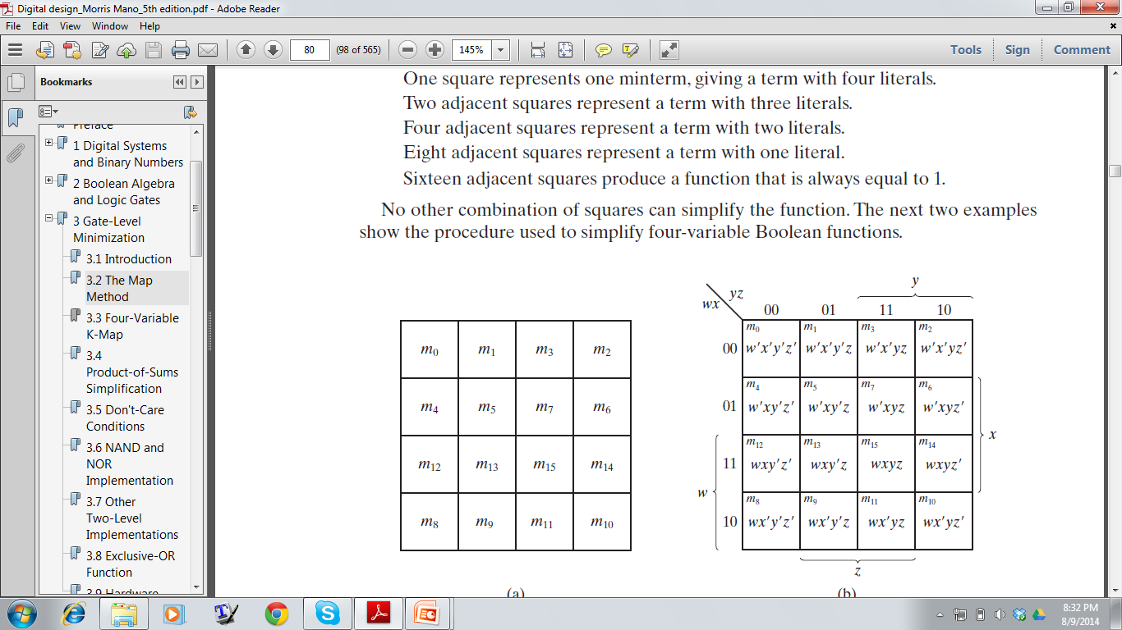
Four Variable K-Map

Slide 12
Four Variable K-Map
F (w, x, y, z) = ∑(0, 1, 2, 4, 5, 6, 8, 9, 12, 13, 14)
YZ
00 | 01 | 11 | 10
WX
00
01
11
10
1 | 1 | 0 | 1
1 | 1 | 0 | 1
1 | 1 | 0 | 1
1 | 1 | 0 | 0

Slide 13
Four Variable K-Map
F (w, x, y, z) = ∑(0, 1, 2, 4, 5, 6, 8, 9, 12, 13, 14)
Y’
W’Z’
YZ
00 | 01 | 11 | 10
WX
00
01
11
10
1 | 1 | 0 | 1
1 | 1 | 0 | 1
1 | 1 | 0 | 1
1 | 1 | 0 | 0
XZ’
F=Y’+W’Z’+XZ’

Slide 14
Four Variable K-Map
One square represents one minterm, giving a term with four literals.
Two adjacent squares represent a term with three literals.
Four adjacent squares represent a term with two literals.
Eight adjacent squares represent a term with one literal.
Sixteen adjacent squares produce a function that is always equal to 1.

Slide 15
Four Variable K-Map
F(A, B, C, D)=∑(0, 2, 3, 5, 7, 8, 9, 10, 11, 13, 15)
YZ
00 | 01 | 11 | 10
WX
00
01
11
10
1 | 0 | 0 | 1
0 | 1 | 1 | 0
0 | 1 | 1 | 0
1 | 0 | 0 | 1

Slide 16
Four Variable K-Map
F(A, B, C, D)=∑(0, 2, 3, 5, 7, 8, 9, 10, 11, 13, 15)
YZ
00 | 01 | 11 | 10
WX
X’Z’
00
01
11
10
1 | 0 | 0 | 1
0 | 1 | 1 | 0
0 | 1 | 1 | 0
1 | 0 | 0 | 1
XZ
F=XZ+X’Z’

Slide 17
Five Variable K-Map
F(A,B,C,D,E) = (0,2,4,6,9,11,13,15,17,21,25,27,29,31)
= BE+AD’E+A’B’E’ (Using following K-MAP)
 | 000 | 001 | 011 | 010 | 110 | 111 | 101 | 100
00 | 1 | 0 | 0 | 1 | 1 | 0 | 0 | 1
01 |  | 1 | 1 |  |  | 1 | 1
11 |  | 1 | 1 |  |  | 1 | 1
10 |  | 1 |  |  |  |  | 1

Slide 18
Completely Specified function: Function output is specified for each combination of input variables
Incompletely Specified function: Functions that have unspecified output for some input combinations.

Slide 19
Don’t Care Conditions
Simplify the Boolean function F (w, x, y, z) = ∑(1, 3, 7, 11, 15) which has the don’t-care conditions: d (w, x, y, z) = (0, 2, 5)
yz
00 | 01 | 11 | 10
wx
Choose to include each don’t-care minterm with either the 1’s or the 0’s, depending on which combination gives the simplest expression.
00
01
11
10
X | 1 | 1 | X
0 | X | 1 | 0
0 | 0 | 1 | 0
0 | 0 | 1 | 0

Slide 20
Don’t Care Conditions
Simplify the Boolean function F (w, x, y, z) = ∑(1, 3, 7, 11, 15) which has the don’t-care conditions: d (w, x, y, z) = (0, 2, 5)
YZ
W’X’
00 | 01 | 11 | 10
WX
00
01
11
10
X | 1 | 1 | X
0 | X | 1 | 0
0 | 0 | 1 | 0
0 | 0 | 1 | 0
F= W’X’ + YZ
YZ
Notes:
The 0101 position is considered 0. because if you consider this 1, then you have to make another box enclosing the 0001,0011,0101, and 0111 squares. It adds an extra term to the function which increase gate number. So consider that as zero.
However, if the 0100 square was 1, then you should have considered that 0101 cell as 1 since in that case you get a bigger box enclosing the 0000,0001,0100,0101 squares.

Slide 21
Don’t Care Conditions
Simplify the Boolean function F (w, x, y, z) = ∑(1, 3, 7, 11, 15) which has the don’t-care conditions: d (w, x, y, z) = (0, 2, 5)
YZ
00 | 01 | 11 | 10
WX
00
01
11
10
X | 1 | 1 | X
0 | X | 1 | 0
0 | 0 | 1 | 0
0 | 0 | 1 | 0
W’Z
F= W’Z + YZ
YZ
Notes:
Either one of the preceding two expressions satisfies the conditions stated for this
example. As far as the incompletely specified function is concerned,
either expression is acceptable because the only difference is in the value of F for the
don’t-care minterms.

Slide 22
Don’t Care Conditions
Simplify the Boolean function F (w, x, y, z) = ∑(1, 3, 7, 11, 15) which has the don’t-care conditions: d (w, x, y, z) = (0, 2, 5)
YZ
00 | 01 | 11 | 10
WX
00
01
11
10
X | X | 1 | X
0 | 0 | X | X
0 | 0 | 1 | 0
X | 0 | 1 | 1

Slide 23
Don’t Care Conditions
Simplify the Boolean function F (w, x, y, z) = ∑(1, 3, 7, 11, 15) which has the don’t-care conditions: d (w, x, y, z) = (0, 2, 5)
YZ
00 | 01 | 11 | 10
WX
X’Z’
00
01
11
10
X | X | 1 | X
0 | 0 | X | X
0 | 0 | 1 | 0
X | 0 | 1 | 1
F= X’Z’ + YZ
YZ

Slide 24
Product-of-Sums Simplification
Express the following function F (A, B, C, D) as a Product of Sums
CD
00 | 01 | 11 | 10
AB
00
01
11
10
1 | 1 | 0 | 1
0 | 1 | 0 | 0
0 | 0 | 0 | 0
1 | 1 | 0 | 1
Step 1: Group the minterms having value 0
F’ = AB + CD + BD’
BD’
AB
CD

Slide 25
Product-of-Sums Simplification
Express the following function F (A, B, C, D) as a Product of Sums
CD
00 | 01 | 11 | 10
AB
00
01
11
10
1 | 1 | 0 | 1
0 | 1 | 0 | 0
0 | 0 | 0 | 0
1 | 1 | 0 | 1
Step 2: Apply the DeMorgan’s theorem
(F’)’ = (AB + CD + BD’)’
F = (A’+B’)(C’+D’)(B’+D)
BD’
AB
CD

Slide 26
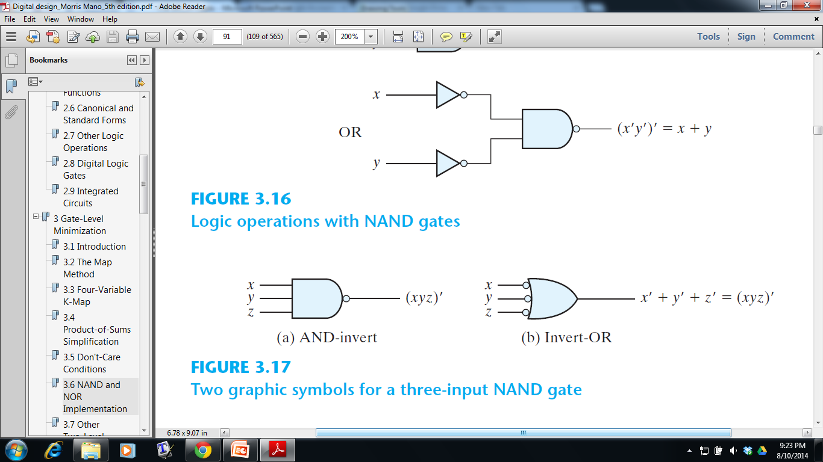
NAND Gate

Slide 27
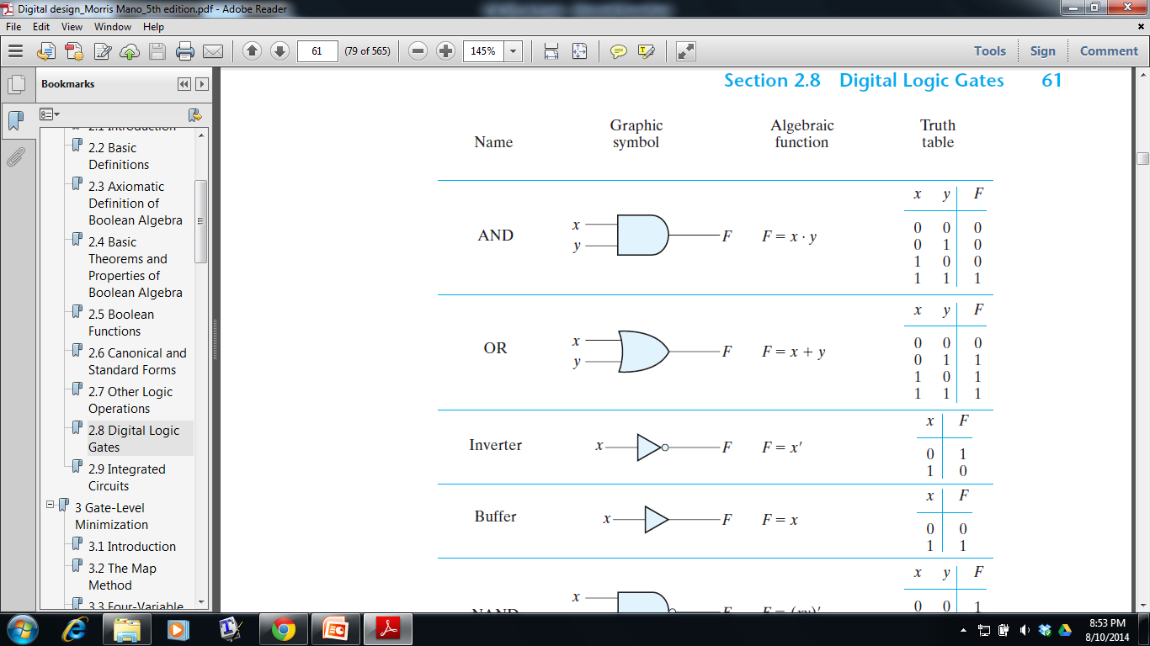
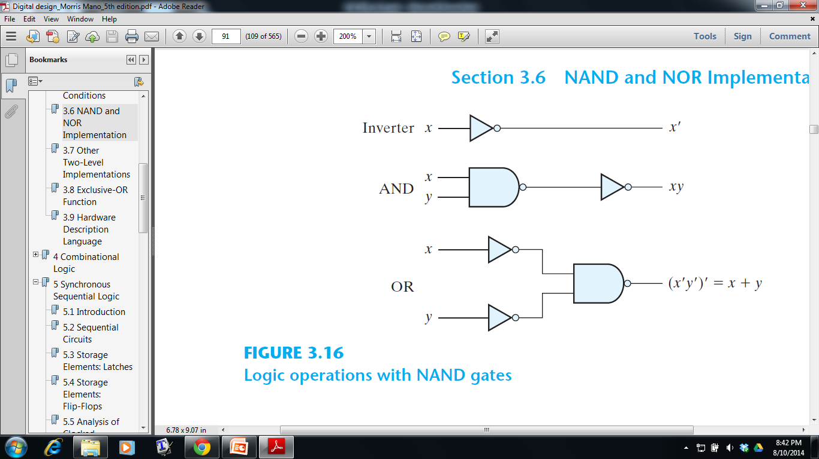
NAND Implementation
NAND gate is the universal gate
All three basic logical operations AND, OR, NOT can be implemented with it
Any logic circuit can be implemented with it
Notes:
Digital circuits are frequently constructed with NAND or NOR gates rather than with AND and OR gates. Because all basic logics AND, OR and NOT can be implemented with two level NAND gates. If similar gates are used in a circuit then it becomes easier to fabricate with several electronic components.

Slide 28
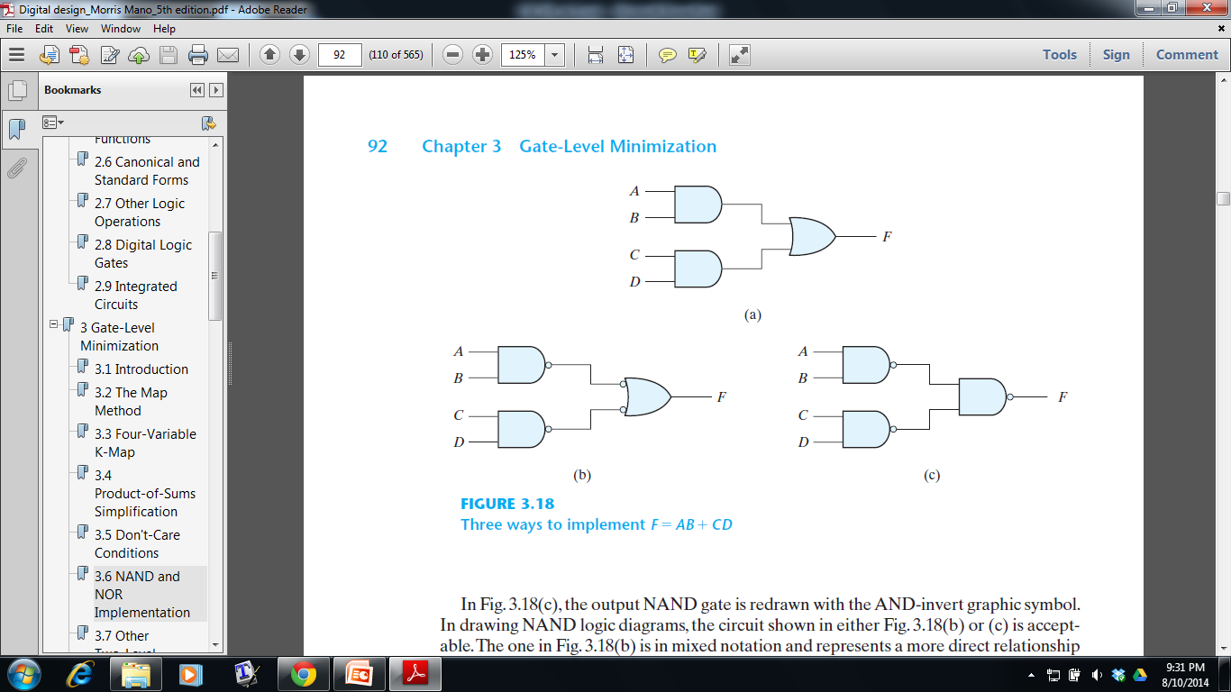
Cancel Out!

Slide 29
Easier Technique
Obtain the simplified Boolean function in Sum of products form (Standard form)
Then convert the function to NAND logic by complementing the function double time
AB + CD
AB + CD
(AB ). (CD)

Slide 30
Implement the following Boolean function with
NAND gates: F (x, y, z) = (1, 2, 3, 4, 5, 7)

Slide 31
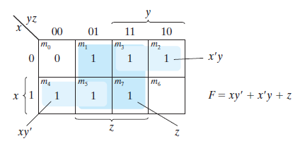
Implement the following Boolean function with
NAND gates: F (x, y, z) = (1, 2, 3, 4, 5, 7)
Step 1: Simplify the function into sum-of-products form
using K-Map

Slide 32
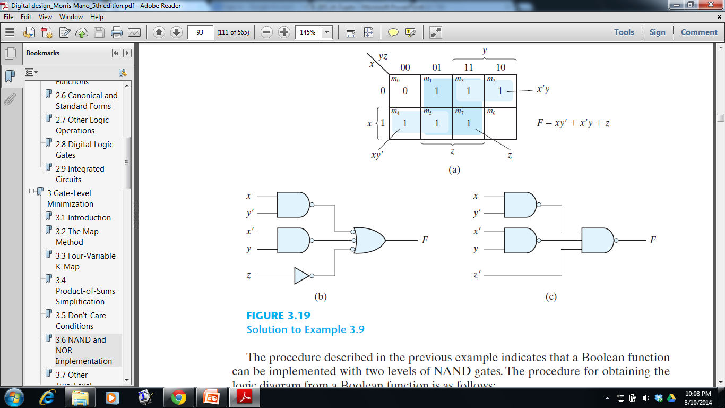
Implement the following Boolean function with
NAND gates: F (x, y, z) = (1, 2, 3, 4, 5, 7)
Step 2: Convert the function to NAND logic
F = xy’ + x’y + z
F = xy’ + x’y + z
F = (xy’).(x’y).(z)

Slide 33
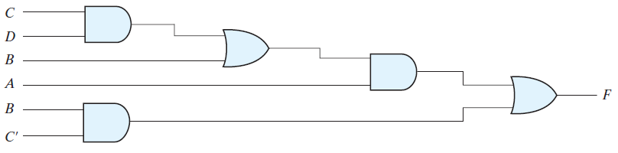
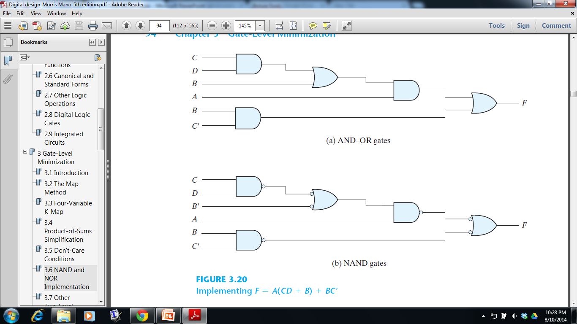
Multilevel NAND Circuits
If the boolean function is not in standard form, it results in three or more levels gating structure
F = A (CD + B) + BC’
Notes:
Four levels

Slide 34
Multilevel NAND Circuits
If the boolean function is not in standard form, it results in three or more levels gating structure
F = A (CD + B) + BC’
Notes:
Four levels

Slide 35
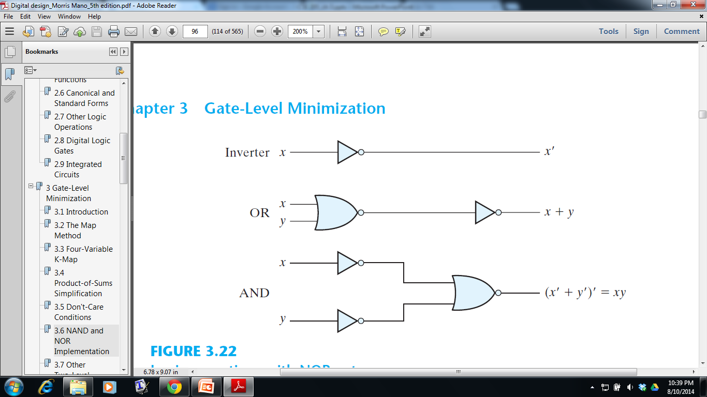
NOR Implementation
NOR gate is the another universal gate
NOR operation is the dual of the NAND operation
All procedures and rules for NOR logic are the duals of the corresponding procedures and rules developed for NAND logic

Slide 36
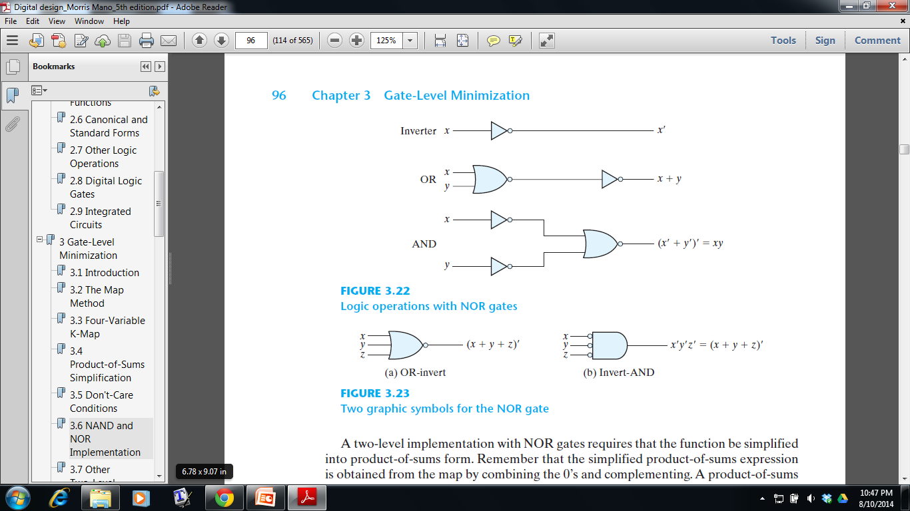

Slide 37
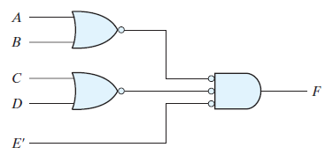
NOR Implementation
Technique
Obtain the simplified Boolean function in Product of Sums form (Standard form) (using K-Map)
Then convert the function to NOR logic by complementing the function double time
(A + B)(C + D)E
(A + B)(C + D)E
(A + B)+(C + D)+E

Slide 38
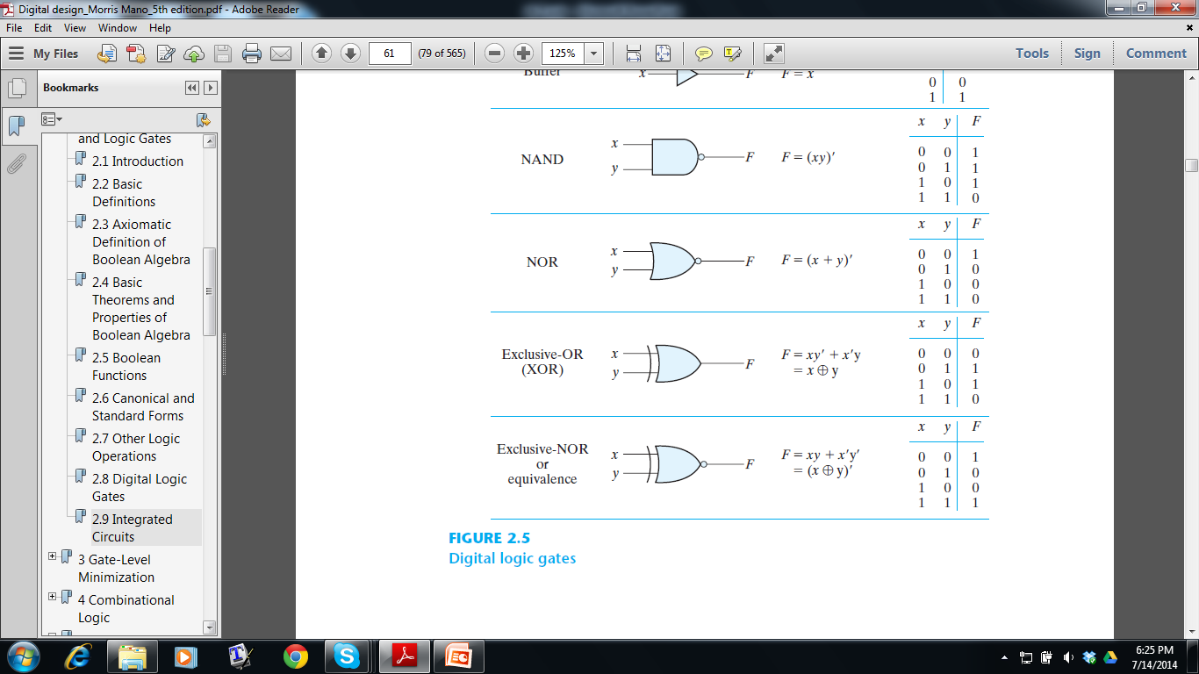
Exclusive – OR (XOR)
Notes:
The exclusive-OR is equal to 1 if only x is equal to 1 or if only y is equal to 1
The exclusive-NOR is equal to 1 if both x and y are equal to 1 or if both are equal to 0.

Slide 39
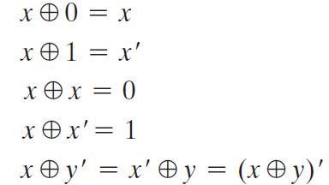
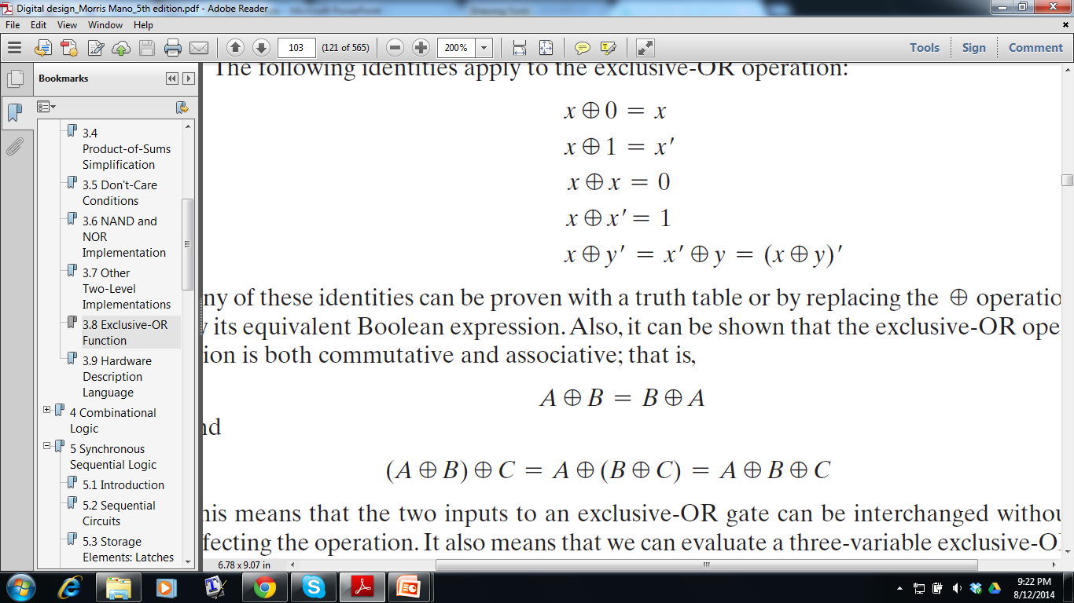
Exclusive – OR (XOR)
The following identities apply to the exclusive-OR operation:
XOR is commutative and associative

Slide 40
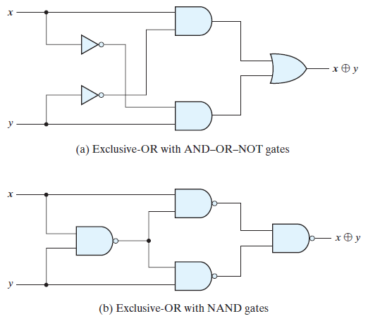
Exclusive – OR (XOR)

Slide 41
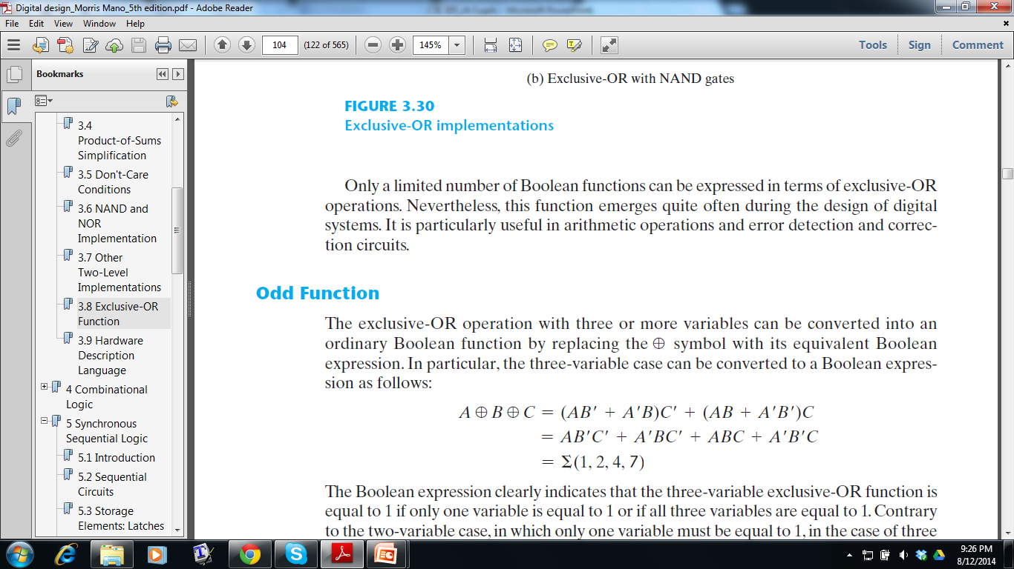
Exclusive – OR (XOR): Three Variable
(2³ / 2 = 4 minterms, each having odd number of 1’s)
A | B | C | Designation
0 | 0 | 0 | m₀
0 | 0 | 1 | m₁
0 | 1 | 0 | m₂
0 | 1 | 1 | m₃
1 | 0 | 0 | m₄
1 | 0 | 1 | m₅
1 | 1 | 0 | m₆
1 | 1 | 1 | m₇

Slide 42
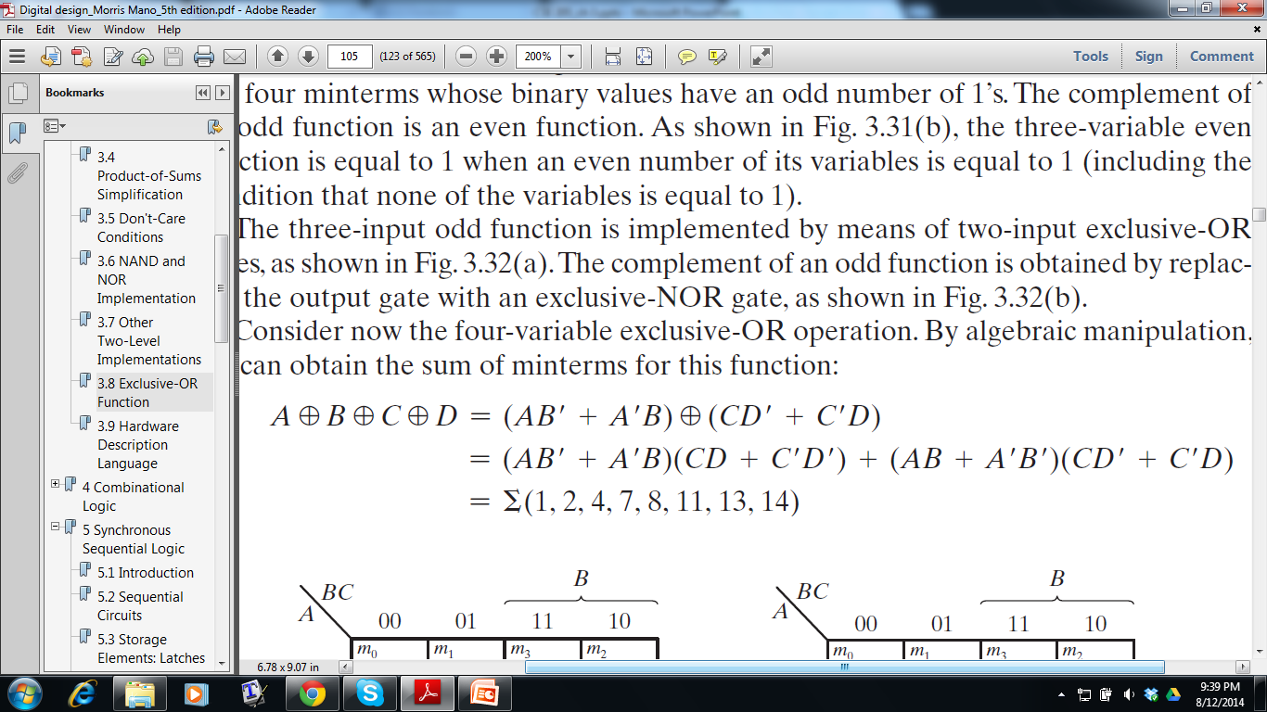
Exclusive – OR (XOR): Four Variable
A | B | C | D
0 | 0 | 0 | 0
0 | 0 | 0 | 1
0 | 0 | 1 | 0
0 | 0 | 1 | 1
0 | 1 | 0 | 0
0 | 1 | 0 | 1
0 | 1 | 1 | 0
0 | 1 | 1 | 1
1 | 0 | 0 | 0
1 | 0 | 0 | 1
1 | 0 | 1 | 0
1 | 0 | 1 | 1
1 | 1 | 0 | 0
1 | 1 | 0 | 1
1 | 1 | 1 | 0
1 | 1 | 1 | 1
(2⁴ / 2 = 8 minterms, each having odd number of 1’s)

Slide 43
Odd Function
An n -variable Exclusive-OR function is an Odd function defined as the logical sum of the 2^{n}/2 minterms whose binary numerical values have an odd number of 1’s

Slide 44
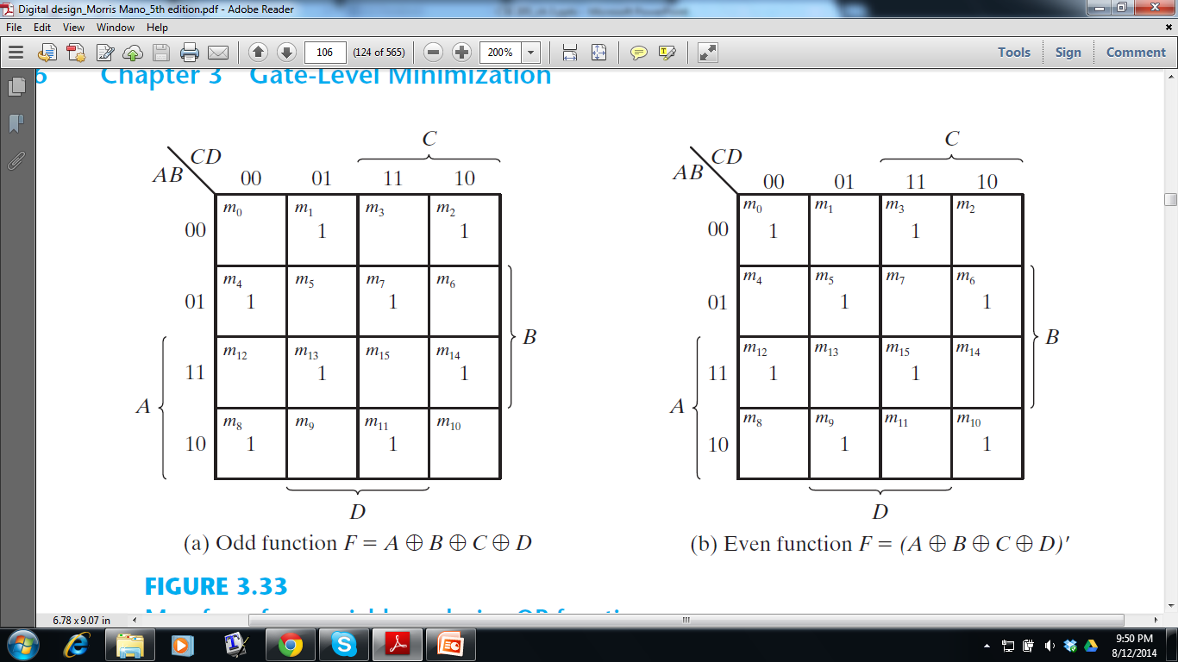
Even Function
The complement of an odd function is an even function
Notes:
NOR function is an even function

Slide 45
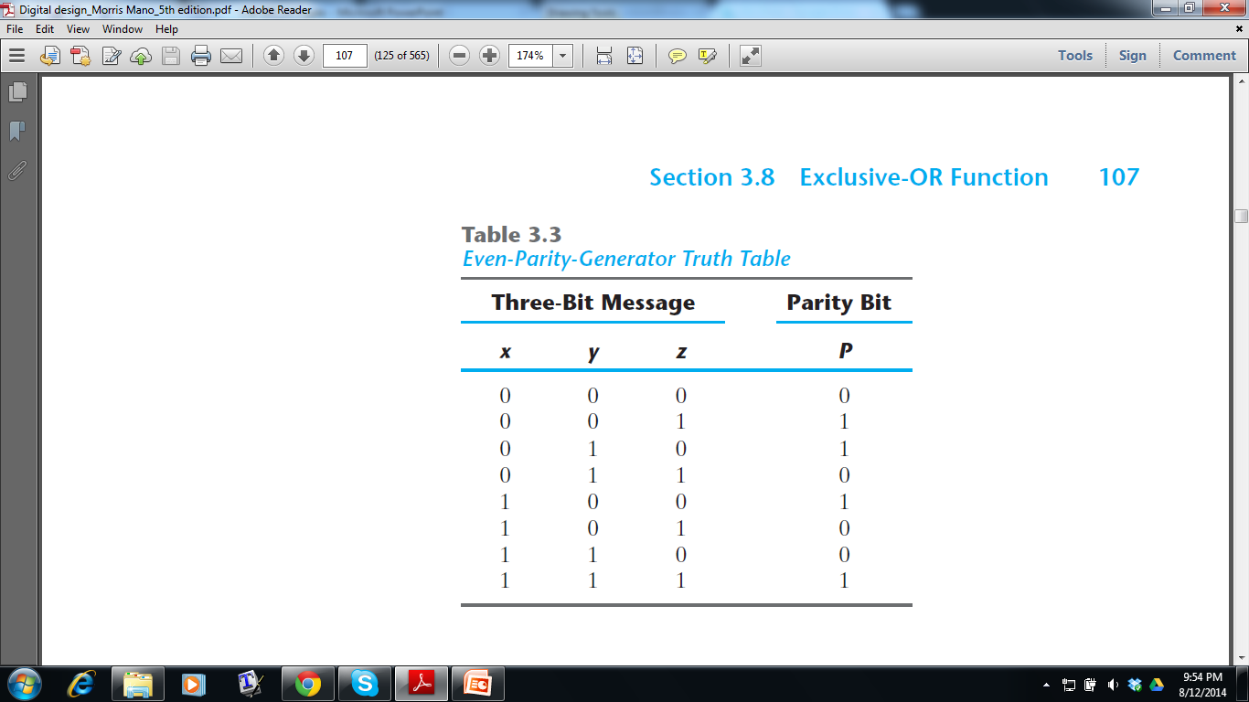
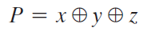
Parity Generation and Checking
P=1 for those minterms whose numerical values have an odd number of 1’s
- It’s a Odd Function!
Notes:
odd function because it is equal to 1 for those minterms whose numerical values have an odd number of 1’s. Therefore, P can be expressed as a three-variable exclusive-OR function

Slide 46
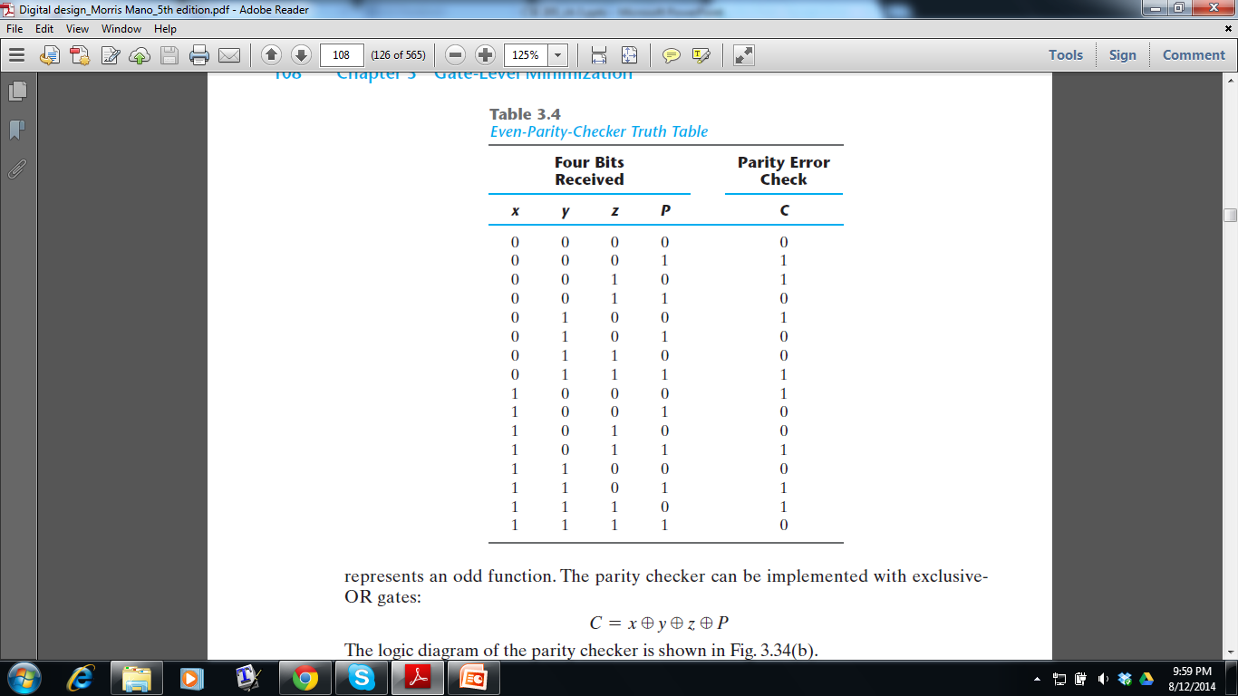
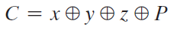
Parity Generation and Checking
C=1 for those minterms whose numerical values have an odd number of 1’s
- It’s a Odd Function!
Notes:
odd function because it is equal to 1 for those minterms whose numerical values have an odd number of 1’s. Therefore, P can be expressed as a three-variable exclusive-OR function

Slide 47
Chapter 3
Section: 3.1, 3.2, 3.3, 3.4, 3.5, 3.6, 3.8

